Slide 1
Classifications Algorithms Hanseeka Dhingana

Slide 2
Agenda
Classification
Types of Classification Algorithms
Linear Classifiers
Logistic Regression
Naïve Bayes Classifier
Perceptron
Support Vector Machines

Slide 3
Classification
Classification algorithms are used to categorize data into different classes or groups. They are a type of supervised learning where the model learns from labeled data.
Example: Predicting whether an email is spam (class 1) or not spam (class 0).

Slide 4
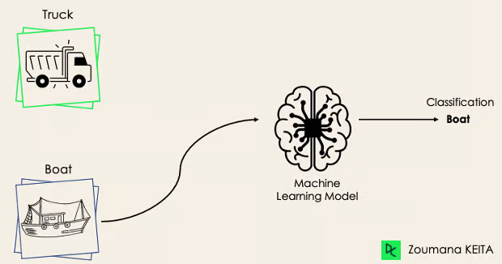
Types of Classification
Binary or Binomial Classification
This is a type of classification where the output is one of two possible classes.

Slide 5
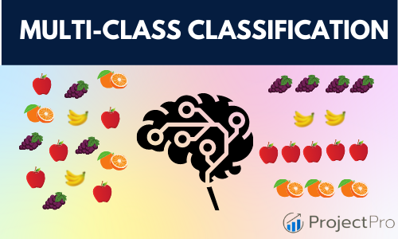
Types of Classification
2) Multi-Class or Multinomial Classification
This is a type of classification where the output can be one of three or more classes.

Slide 6
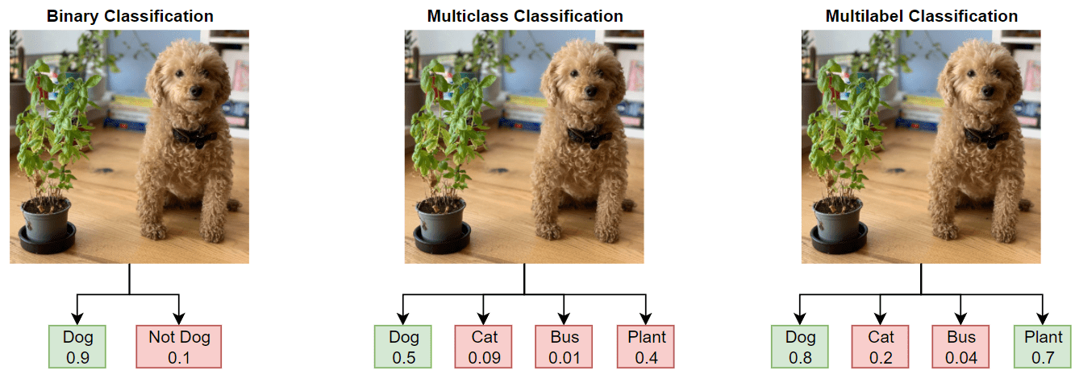
Types of Classification

Slide 7
Types of Classification Linear Classifier or non-Linear Classifier
Linear classifiers use a straight line, plane, or hyperplane to separate classes, while non-linear classifiers use curves or complex surfaces to separate classes when the data is not linearly separable.

Slide 8
Linear Classifier
Models that separate data using a linear decision boundary (e.g., straight line or hyperplane).
They find weights (coefficients) to minimize classification error.
Examples: Logistic Regression, Linear SVM
When to use?
When data is linearly separable.
For simplicity and interpretability.

Slide 9
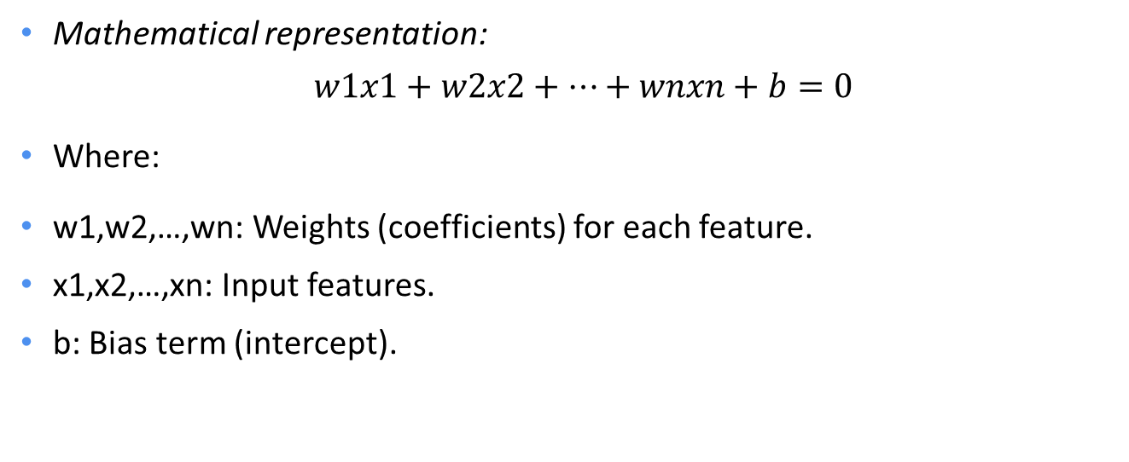
Linear Classifier
Mathematical representation:
$$w1​x1​+w2​x2​+⋯+wn​xn​+b=0$$
Where:
w1,w2,…,wn​: Weights (coefficients) for each feature.
x1,x2,…,xn: Input features.
b: Bias term (intercept).

Slide 10
Classifications models 1) Logistic Regression 2) Naïve Bayes Classifier 3) Perceptron 4) Support Vector Machines

Slide 11
1) Logistic Regression
Logistic Regression is a statistical method used for binary classification (predicting one of two possible outcomes).
It models the probability that a given input belongs to a certain class using the logistic function (also called the sigmoid function).

Slide 12
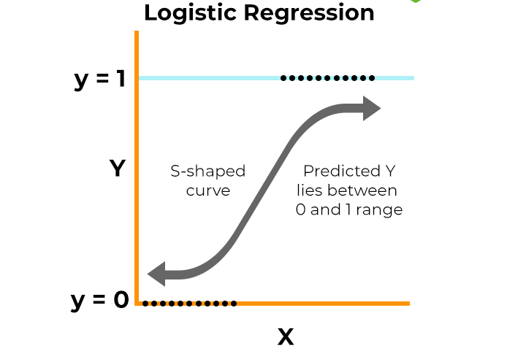

1) Logistic Regression Sigmoid function
$$Y =\frac{1}{1+e^{−(a0+a1x)}}$$

Slide 13
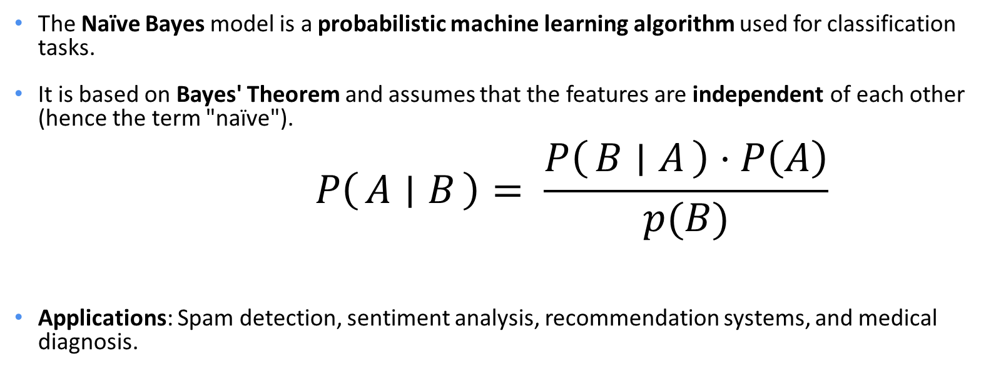
2) Naïve Bayes Classifier
The Naïve Bayes model is a probabilistic machine learning algorithm used for classification tasks.
It is based on Bayes' Theorem and assumes that the features are independent of each other (hence the term "naïve").
$$P\left(A ∣ B\right)= \frac{P\left(B ∣ A\right)⋅P\left(A\right)}{p(B)}$$
Applications: Spam detection, sentiment analysis, recommendation systems, and medical diagnosis.

Slide 14
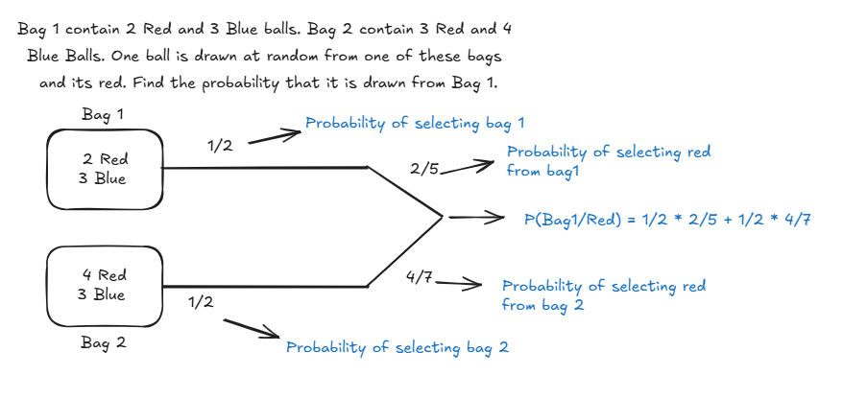
2) Naïve Bayes Classifier

Slide 15
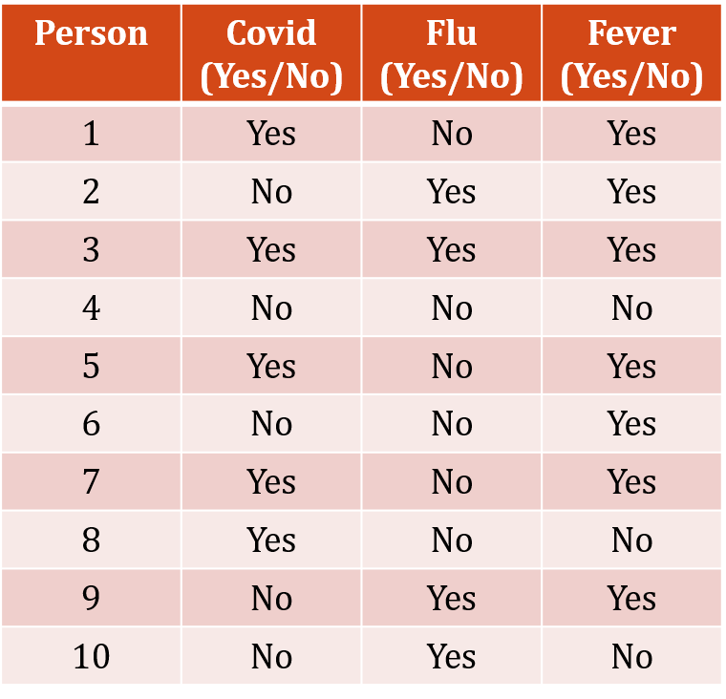
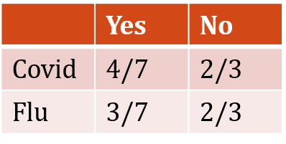
2) Naïve Bayes Classifier
Step-1: Prior Probability
P(fever = yes) = 7/10
P(fever = no) = 3/10
Step-2: Conditional Probability
Given Person(flu, Covid)
P(yes | flu, covid) = P(flu | yes) * P(covid | yes) * P(yes)
P(No | flu, covid) = P(flu | No) * P(covid | No) * P(No)

Slide 16
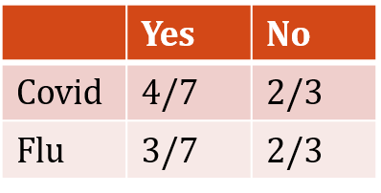
2) Naïve Bayes Classifier
Given Person(flu, Covid)
P(yes | flu, covid) = P(flu | yes) * P(covid | yes) * P(yes) = 3/7 * 4/7 * 7/10 = 0.17
P(No | flu, covid) = P(flu | No) * P(covid | No) * P(No) = 2/3 * 2/3 * 3/10 = 0.13
0.17 > 0.13 → Person has fever.

Slide 17
3) Perceptron Model
The Perceptron is one of the simplest and earliest models used in machine learning for binary classification. It is the building block of neural networks.
The Perceptron is a linear classifier that learns a decision boundary to separate two classes.
It takes a set of input features, applies weights to them, and produces an output (prediction) based on a threshold.
The Perceptron updates the weights and bias only when the prediction is incorrect.

Slide 18
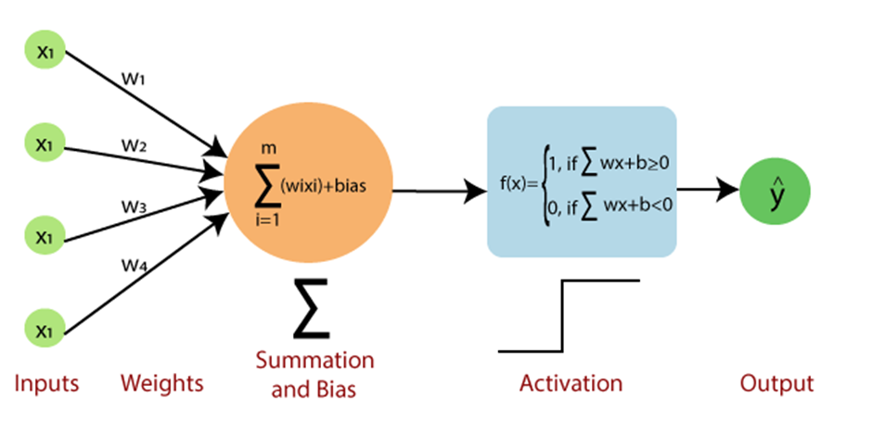
3) Perceptron Model

Slide 19
4) Support Vector Machine (SVM)
The Support Vector Machine (SVM) is a powerful machine learning algorithm used for classification and regression tasks.
It is particularly effective for complex datasets where the classes are not easily separable.
How SVM Works:
SVM tries to find the best boundary (called a hyperplane) that separates the data into different classes.
This boundary is chosen to maximize the margin, which is the distance between the boundary and the closest data points from each class.
The closest data points to the boundary are called support vectors.

Slide 20
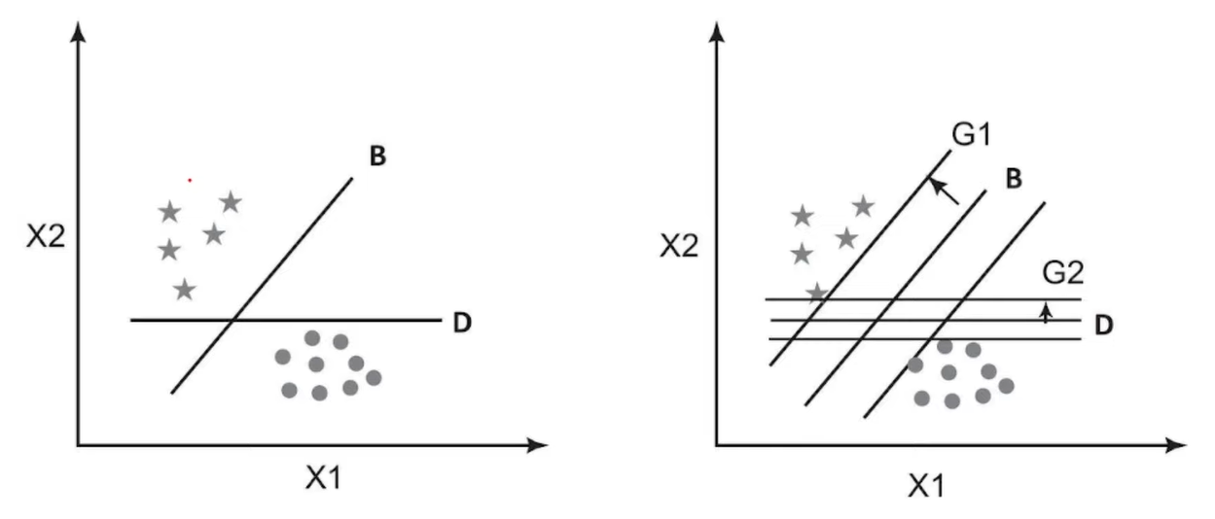
Margin (SVM)

Slide 21
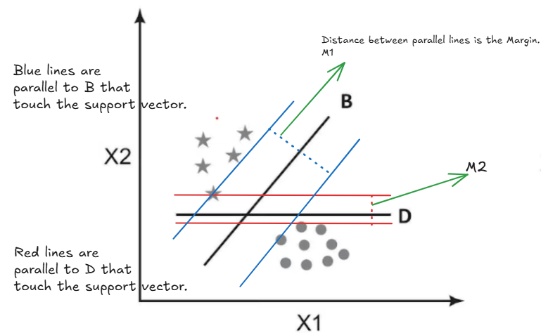
Margin (SVM)

Slide 22
Thank you

